Slide 1
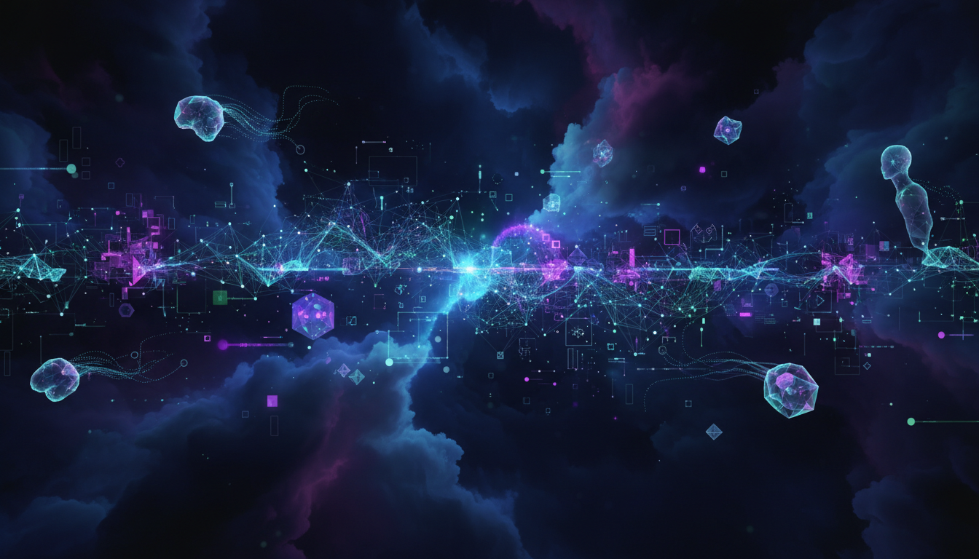
Generative AI for Beginners
Build Your First Agent with Azure AI Foundry
From zero to AI hero - watch your first agent come alive in just a few lines of code
Niels Berglund
AI / Software Architect Lead Derivco
niels.it.berglund@gmail.com
https://nielsberglund.com
https://linkedin.com/in/nielsberglund

Slide 2

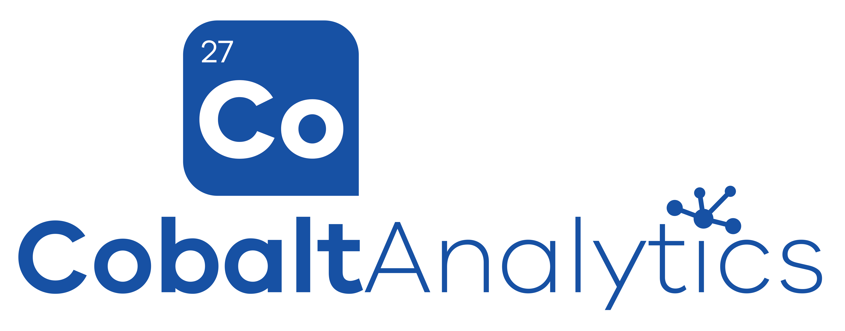
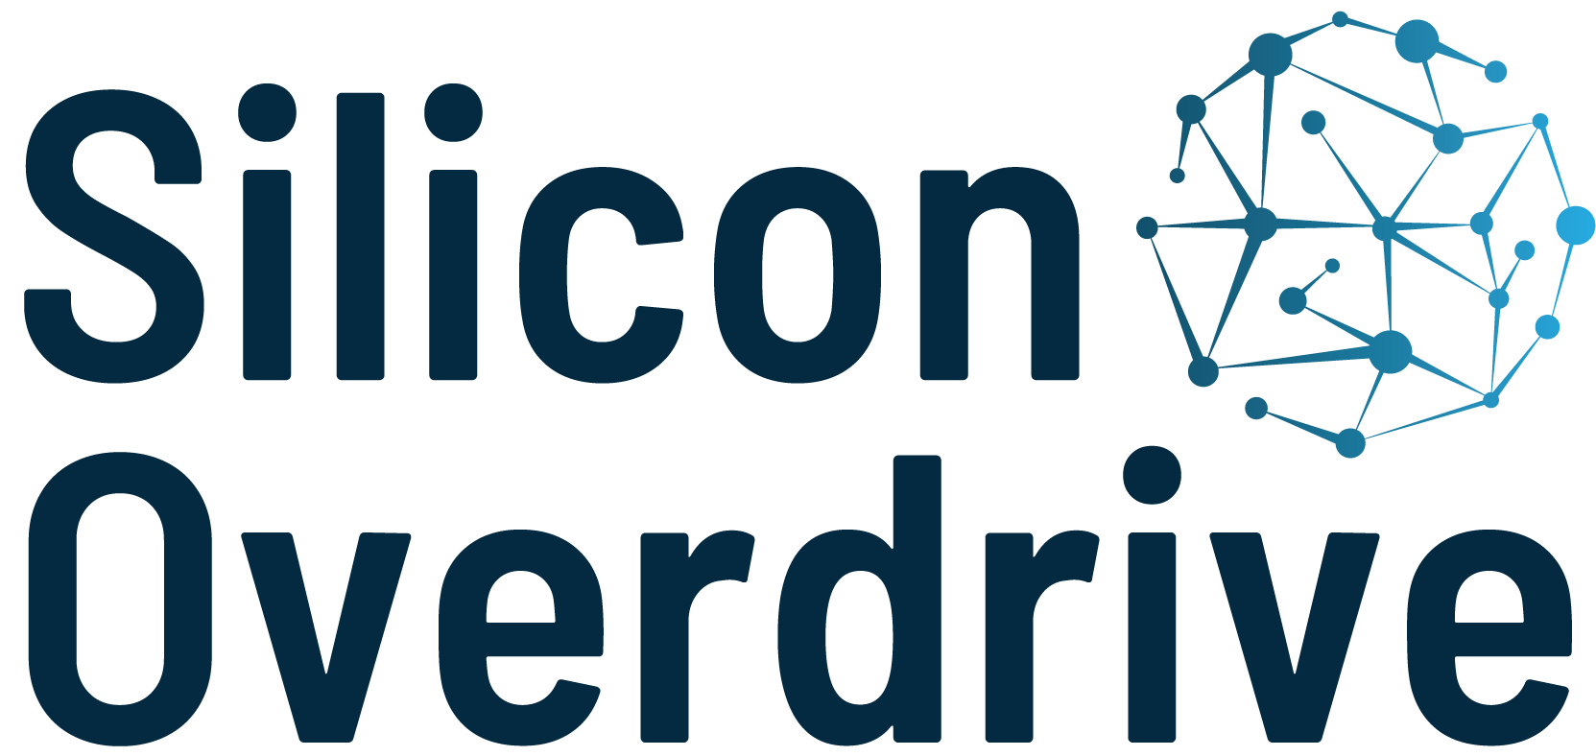
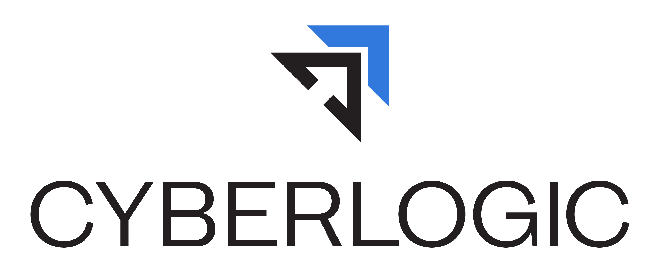
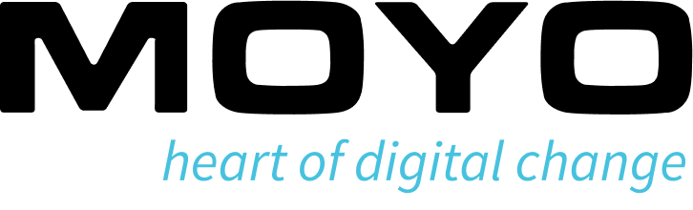
Thanks to the Sponsors Days like today are only possible because of them.

Slide 3
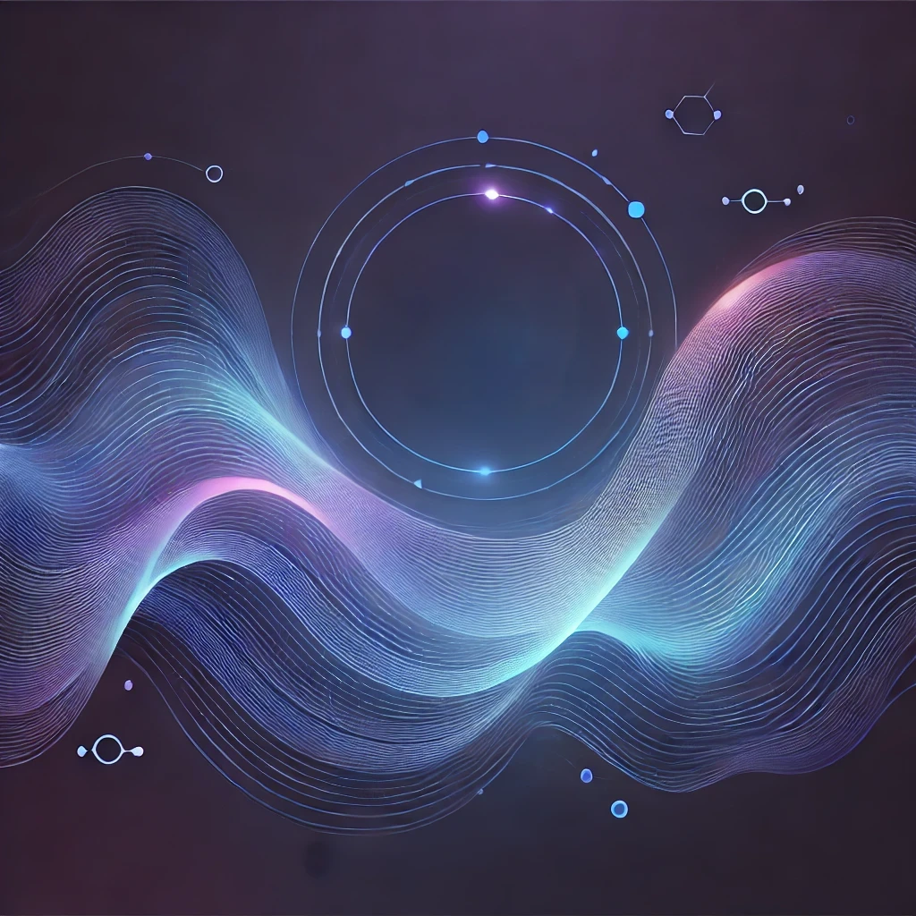
What We'll Build Today
✓ An AI agent in Azure AI Foundry
✓ A working application connected to the agent
✓ End-to-end demo you can use
In the next hour: from nothing to working!
You'll leave with code you can use

Slide 4
The Date
30 November 2022
Notes:
The world as we know it began on this date. What happened then?
ChatGPT was released, and the world became aware of GenAI.

Slide 5
What is Generative AI?
AI models that create new content
Examples:
• Text (conversations, summaries, code)
• Images (art, designs)
• Audio (voice, music)
Think: AI that can generate, not just analyze

Slide 6
What is an AI Agent?
AI that can take actions (not just chat)
Agent vs. Simple Chatbot:
• Chatbot: answers questions
• Agent: performs tasks, makes decisions
Real-world examples:
• Customer support that creates tickets
• Research assistant that finds information
• Code helper that writes and tests code

Slide 7
Why Azure AI Foundry?
✓ All-in-one platform for building AI solutions
✓ No need to be an ML expert
✓ Enterprise-ready, secure, scalable
✓ Built-in tools for testing and deployment
Perfect for beginners and experts alike!

Slide 8
Today's Architecture
USER YOUR APPLICATION AZURE AI FOUNDRY (Agent) RESPONSE back to user
"Don't worry, this is easier than it looks!"

Slide 9
Let's Build! Part 1 - The Agent
What we'll do:
✓ Set up Azure AI Foundry
✓ Create an agent
✓ Configure prompts
✓ Test in playground
Minimal slides from here - let's code!

Slide 10
Let's Build! Part 2 - The Application
What we'll do:
✓ Create a simple front-end app
✓ Connect to our agent
✓ Handle user input/output
✓ See it work end-to-end
Keep watching - this is where it gets fun!

Slide 11
What We Built Today
✓ Created an AI agent in Azure AI Foundry
✓ Configured it with prompts
✓ Gave it knowledge, and the ability to execute code
✓ Connected it to a real application
✓ Made it work end-to-end
And you can do this too!

Slide 12
Key Takeaways
✓ Generative AI is accessible to everyone
✓ Azure AI Foundry makes it easier
✓ You don't need to be an AI expert
✓ Start small, iterate, improve
✓ The code is simpler than you think

Slide 13
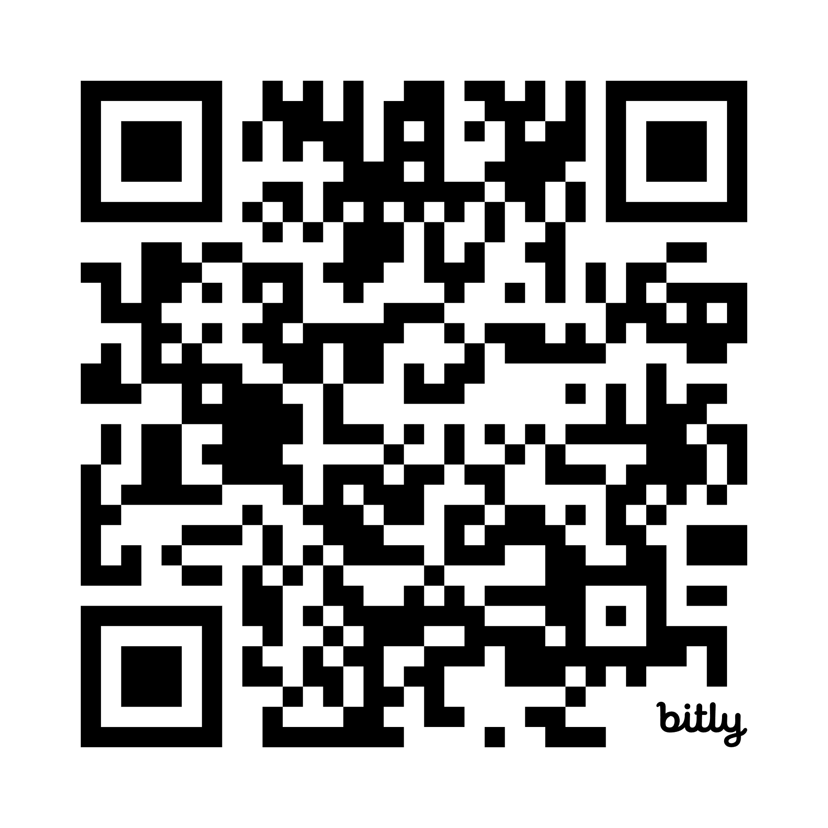
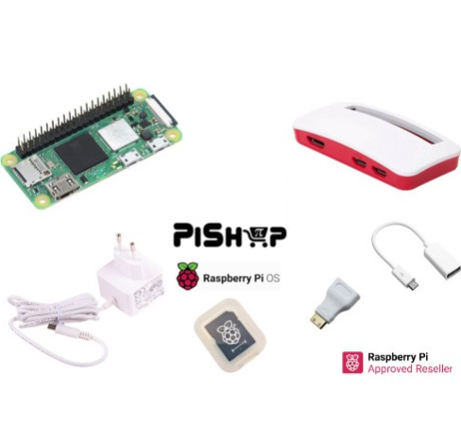
SESSION FEEDBACK Please use this QR Code to complete the speaker feedback form. Each completed form gives you an entry to win one of our awesome prizes.
bit.ly/4ohBmt6

Slide 14
Thank You Questions?
Niels Berglund
niels.it.berglund@gmail.com
https://nielsberglund.com
https://linkedin.com/in/nielsberglund

